Slide 1
Routine Detection
Duo Liu ,Lijian Wan, Chang Liu

Slide 2
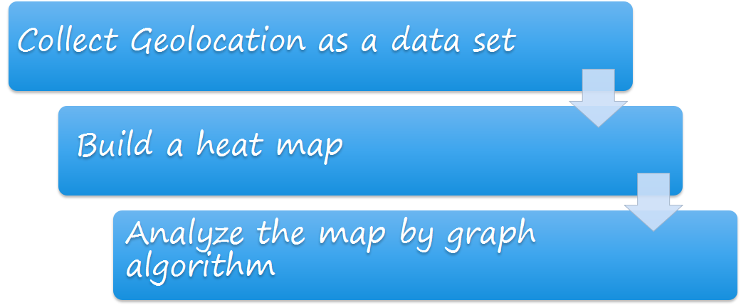
Approach

Slide 3
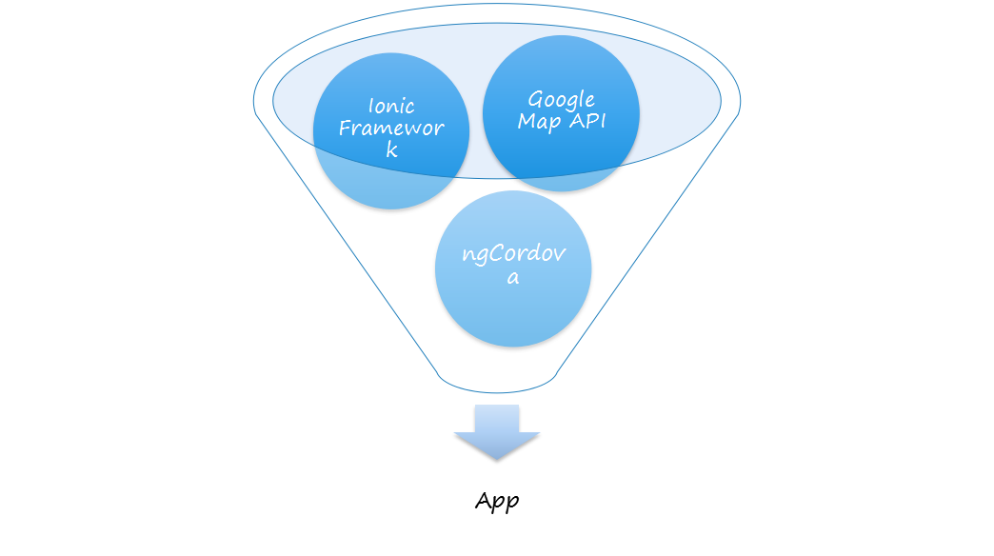
What we used in this app

Slide 4
Video Demo

Slide 5
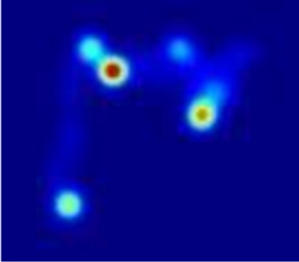
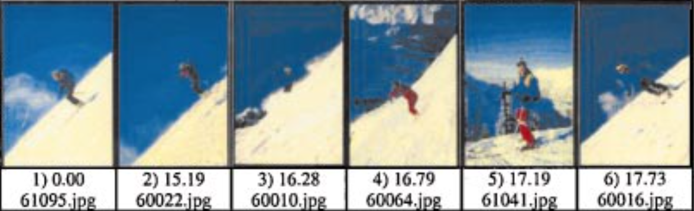
Data Analysis
Heat Map Generation
Image Similarity
Histogram/Texture/Color
Abnormal Detection
Euclidean distance
Earth's Mover Distance(EMD)

Slide 6
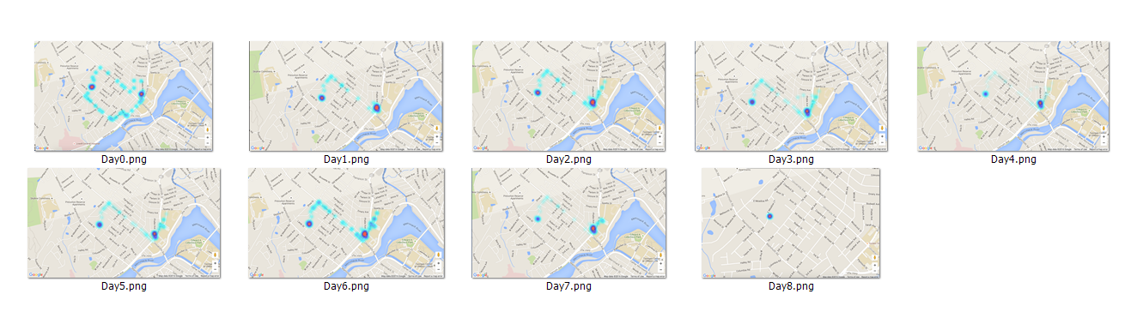
Result
day0 | day1 | day2 | day3 | day4 | day5 | day6 | day7 | day8
12.1730 | 10.8021 | 8.0703 | 10.9072 | 8.2338 | 8.5305 | 9.0507 | 8.6104 | 36.9019

Slide 7
Conclusion
Lack of data set
upload the data into a server
Heat Map’s specific feature
Large dataset training

Slide 8
Thank you

